Slide 1

Analysis of Crime Occurrences in Los Angeles dating back to 2020
Author: Do, Ngan
Instructors: Professor Hong, Lingzi
TA Anik, Anirban Saha
Class: DTSC 3010 Section 020
Date: 12-10-2024

Slide 2
Categories
01
02
03
04
05
06
Abstract
Introduction
Dataset information
EDA process
Models
Summary of learning

Slide 3

01
Abstract

Slide 4

Abstract
My aim
Examining the patterns in crime occurrences
Predicting crime types,
Identify whether crime reports (timely/delayed) based on:
Demographic factors
Location
Time
=> Supporting in developing targeted crime prevention strategies

Slide 5
02
Introduction

Slide 6
The research question:
“What are the key patterns in crime occurrences, and How can we predict crime types and identify whether crime reports are timely or delayed based on demographic factors, location, and time? “
=> Essential for law enforcement agencies and making policies

Slide 7
03
Dataset

Slide 8
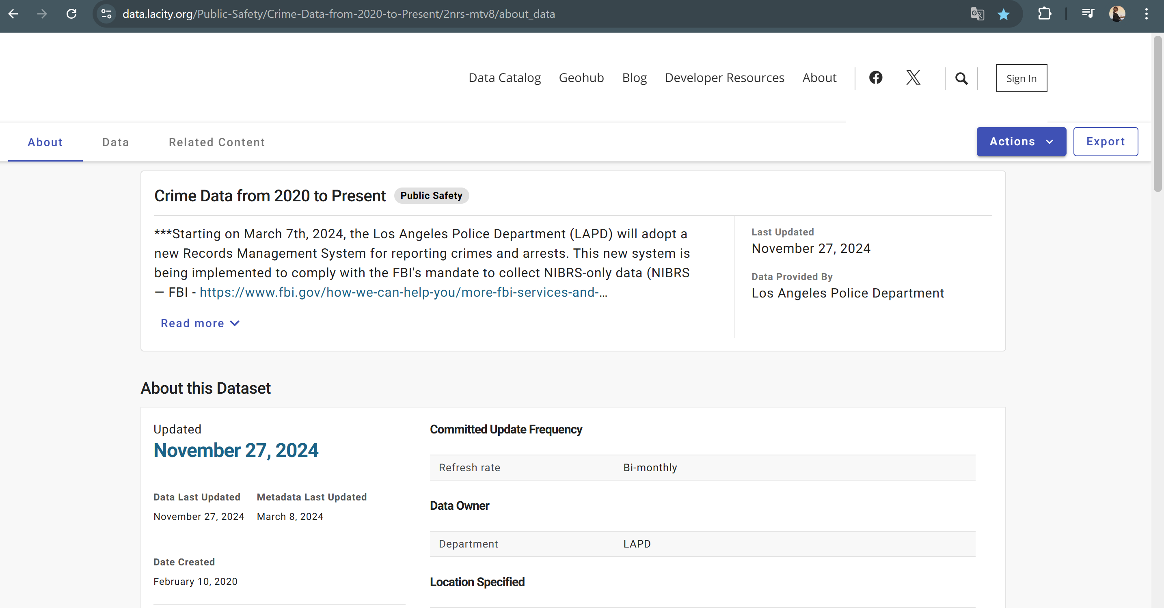

What to show in a mockup
Link: https://data.lacity.org/Public-Safety/Crime-Data-from-2020-to-Present/2nrs-mtv8/about_data

Slide 9
Dataset
Some features:
Victim Age, Descent, Sex for analyzing demographics,
Area, Longitude, Latitude, and Time for exploring spatial and temporal trends.
After preprocessing:
24 columns:
20 original column
4 new columns: Time_to_reports, Delayed_Report, Time_Slots_Happening, Weekdays_of_DateRptd)
9,999 rows:
Reducing dataset size by taking top 3 crime types for Crm.Cd.Desc

Slide 10
04
Exploratory Data Analysis

Slide 11
EDA
To understand the target variable:
ggplot2 library (geom_bar).
To understand the categorical variables:
chisq.test function, ggplot2 library (geom_bar), functions in dplyr library.
To understand the continuous variables:
ggplot2 library(geom_density, geom_smooth)

Slide 12
EDA
T-test: Check the average age of Victims differs significantly between weekends and weekdays.
ANOVA test: Comparing time_to_report across different area.

Slide 13
05
Models

Slide 14
Models
Support Vector Machine
Decision Tree
Random Forest
Classify crime types based on Victim demographics and crime locations.
The comparison about the performance between these models.

Slide 15
WHY: Classify crime types based on Victim demographics and crime locations.
Enacting preventative measures
Investigating effectively
Improving resource allocation

Slide 16
Models
Random Forest: has the best accuracy
Combining predictions from multiple decision trees
decreasing overfitting problems
increasing good generalization of data

Slide 17
Models
Logistic Regression
Classify Time.to.reports as Delayed (>1 day) or Timely (<= 1 day)

Slide 18
WHY: Classify Time.to.reports as Delayed (>30 days) or Timely (<= 30days)?
Allocating resources
Improving the function of law enforcement agencies
Preventing Crimes

Slide 19
Models
To evaluate the performance
Confusion Matrix
Summary metrics

Slide 20
06
Summary

Slide 21
Gaining valuable insights in crime in LA
Demographic factors
Geographic factors
Temporal trends
The importance of leveraging data to discover actionable insights.

Slide 22

THANKS!
Do you have any questions?
NganDo2@my.unt.edu
4692162956
https://www.linkedin.com/in/kacie-do-5041bb323/

